Slide 1
When facing the sun
There would be no shadow

Slide 2
Contents
Memories
Favorite City
My Hobbies
Basic Info

Slide 3
First Part
Basic Info
Basic Info

Slide 4
Basic Information
Name: QiaoJia Li
English Name: Crystal
Age: 23
My Family: Father、Mother
Sister and Brother-in-law、
My little nephew

Slide 5
Second Part
My Hobbies
My Hobbies

Slide 6
My Hobbies
Play Ping-Pong
Interesting, Easy
China is the best!

Slide 7
My Hobbies
Friends

Slide 8
Third Part
Favorite City
Favorite City

Slide 9
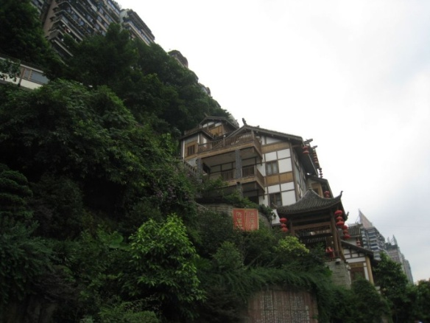
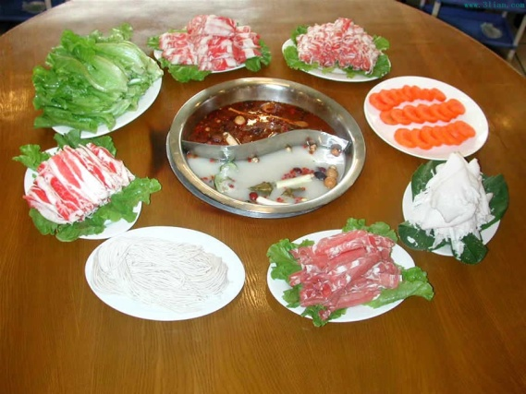
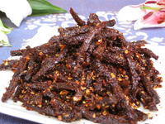
Favorite Cities
ChongQing – Delicious food

Slide 10
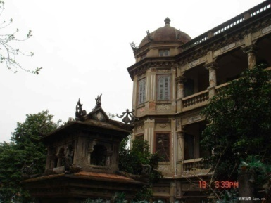
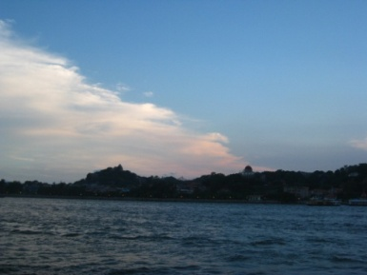
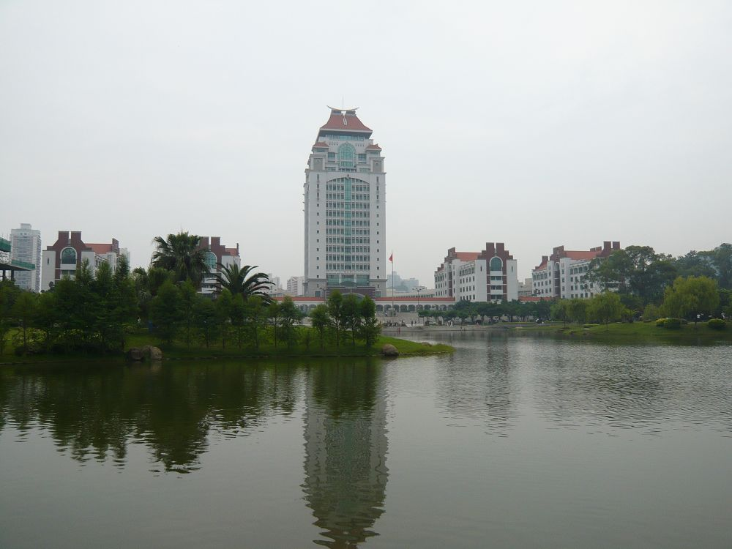
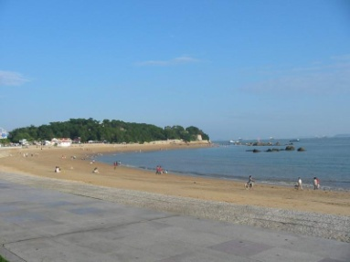
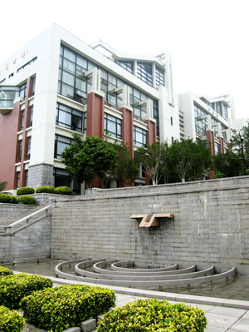
Favorite Cities
XiaMen - Beautiful、Comfortable

Slide 11
Fourth Part
Memories
Memories

Slide 12
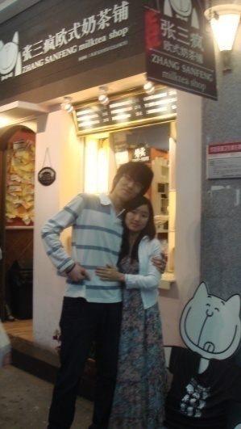
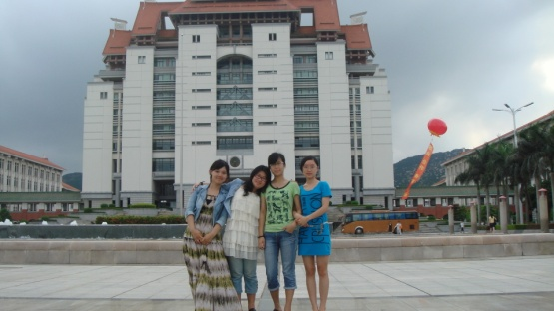
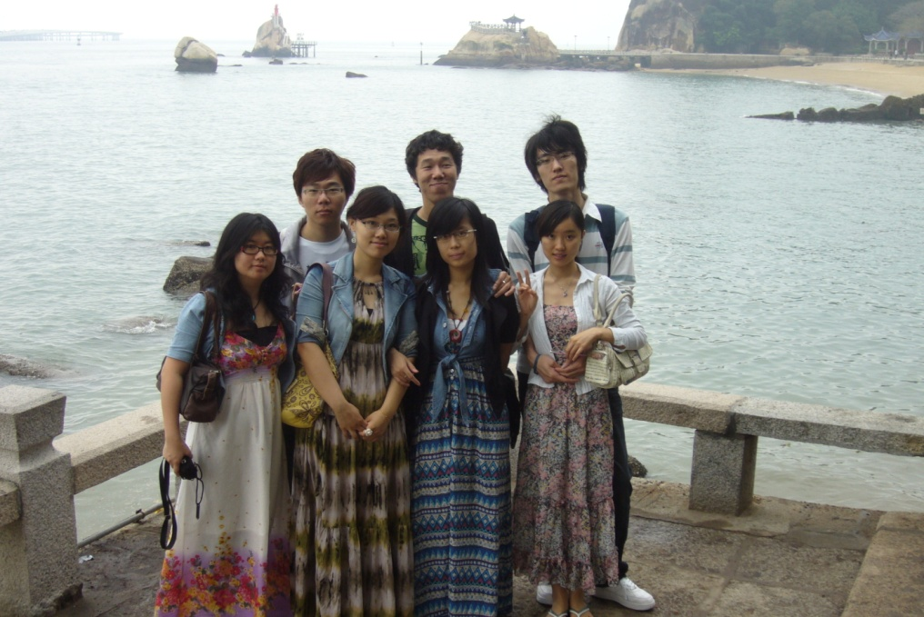
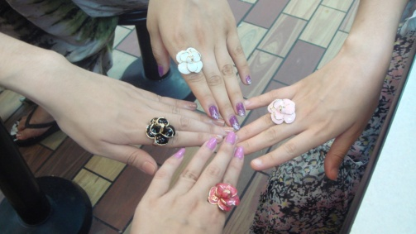
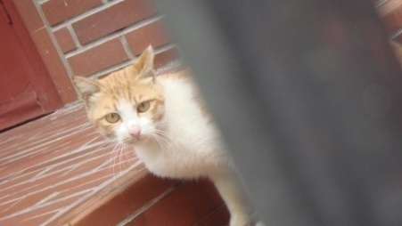
Precious Memories
Never Forget

Slide 13
When facing the sun
There would be no shadow

Slide 14
Thank you!

Slide 15
上万精品PPT模板全部免费下载
PPT汇 www.ppthui.com
PPT模板下载：www.ppthui.com/muban/ 行业PPT模板：www.ppthui.com/hangye/
工作PPT模板：www.ppthui.com/gongzuo/ 节日PPT模板：www.ppthui.com/jieri/
PPT背景图片： www.ppthui.com/beijing/ PPT课件模板：www.ppthui.com/kejian/
Notes:
模板来自于 https://www.ppthui.com 【PPT汇】

Slide 16
10000+套精品PPT模板全部免费下载
www.ppthui.com
PPT汇
PPT模板下载：www.ppthui.com/muban/ 行业PPT模板：www.ppthui.com/hangye/
工作PPT模板：www.ppthui.com/gongzuo/ 节日PPT模板：www.ppthui.com/jieri/
党政军事PPT：www.ppthui.com/dangzheng/ 教育说课课件：www.ppthui.com/jiaoyu/
PPT模板：简洁模板丨商务模板丨自然风景丨时尚模板丨古典模板丨浪漫爱情丨卡通动漫丨艺术设计丨主题班会丨背景图片
行业PPT：党政军事丨科技模板丨工业机械丨医学医疗丨旅游旅行丨金融理财丨餐饮美食丨教育培训丨教学说课丨营销销售
工作PPT：工作汇报丨毕业答辩丨工作培训丨述职报告丨分析报告丨个人简历丨公司简介丨商业金融丨工作总结丨团队管理
More+
Notes:
模板来自于 https://www.ppthui.com 【PPT汇】

