Slide 1
REPORT
powerpoint business template

Slide 2
Welcome
Our Company
Our Work
Statistics
Portfolio
Projects
Contact
Break
CONTENTS
10 minutes
Unique design
Unique design
Unique design
Unique design
Unique design
Unique design
Unique design
1
2
3
4
5
6
7

Slide 3
OUR COMPANY
Don't aim for success if you want it; just do what you love and believe in, and it will come naturally.

Slide 4
01
Our Company
An Awesome Company
By faith I mean a vision of good one cherishes and the enthusiasm that pushes one to seek its fulfillment regardless of obstacles. By faith I mean a vision of good one cherishes and the enthusiasm that pushes one to seek its fulfillment regardless of obstacles.

Slide 5
02
Service 01
Service 02
Service 03
Our Services
By faith I mean a vision of good one cherishes and the enthusiasm that pushes one to seek its fulfillment regardless of
By faith I mean a vision of good one cherishes and the enthusiasm that pushes one to seek its fulfillment regardless of
By faith I mean a vision of good one cherishes and the enthusiasm that pushes one to seek its fulfillment regardless of
An Awesome Company
By faith I mean a vision of good one cherishes and the enthusiasm that pushes one to seek its fulfillment regardless of obstacles. By faith I mean a vision of good one cherishes and the enthusiasm that pushes one to seek its fulfillment regardless of obstacles.

Slide 6
03
Service 01
Service 02
Service 03
Our Services
I mean a vision of good
I mean a vision of good
I mean a vision of good
Our Company
By faith I mean a vision of good one cherishes and the enthusiasm that pushes one to seek its fulfillment regardless of obstacles. By faith I mean a vision of good one cherishes and the enthusiasm that pushes one to seek its fulfillment regardless of obstacles.
By faith I mean a vision of good one cherishes and the enthusiasm that pushes one to seek its fulfillment regardless of obstacles. By faith I mean a

Slide 7
PARAGRAPH
Don't aim for success if you want it; just do what you love and believe in, and it will come naturally.

Slide 8
04
Paragraph Slide
Don't aim for success if you want it; just do what you love and believe in, and it will come naturally.
But all sunshine without shade, all pleasure without pain, is not life at all. Take the lot of the happiest - it is a tangled yarn. Bereavements and blessings, one following another, make us sad and blessed by turns. Even death itself makes life more loving.
But all sunshine without shade, all pleasure without pain, is not life at all. Take the lot of the happiest - it is a tangled yarn. Bereavements and blessings, one following another, make us sad and blessed by turns. Even death itself makes life more loving. But all sunshine without shade, all pleasure without pain, is not life at all. But all sunshine without shade, all pleasure without pain, is not life at all. But all sunshine without shade, all pleasure without pain, is not life at all.

Slide 9
05
Paragraph Slide
First chapter
By faith I mean a vision of good one cherishes and the enthusiasm that pushes one to seek its fulfillment regardless of obstacles. By faith I mean a vision of good one cherishes and the enthusiasm that pushes one to seek its fulfillment regardless of obstacles. By faith I mean a vision of good one cherishes and the enthusiasm that pushes one to seek
Second chapter
By faith I mean a vision of good one cherishes and the enthusiasm that pushes one to seek its fulfillment regardless of obstacles. By faith I mean a vision of good one cherishes and the enthusiasm that pushes one to seek its fulfillment regardless of obstacles. By faith I mean a vision of good one cherishes and the enthusiasm that pushes one to seek its fulfillment

Slide 10
OUR WORK
Don't aim for success if you want it; just do what you love and believe in, and it will come naturally.

Slide 11
06
Portfolio
Design, develop, and create….

Slide 12
07
Portfolio
Energy,
Communication, clarity and restraint…
A perfect blend of creativities

Slide 13
INTERIOR
DESIGN
INTERIOR
DESIGN
INTERIOR
DESIGN
INTERIOR
DESIGN
08
Portfolio
By faith I mean a vision of good one cherishes and the chain of By faith I mean a vision of
By faith I mean a vision of good one cherishes and the chain of By faith I mean a vision of
By faith I mean a vision of good one cherishes and the chain of By faith I mean a vision of
By faith I mean a vision of good one cherishes and the chain of By faith I mean a vision of

Slide 14
STATISTICS
Don't aim for success if you want it; just do what you love and believe in, and it will come naturally.

Slide 15
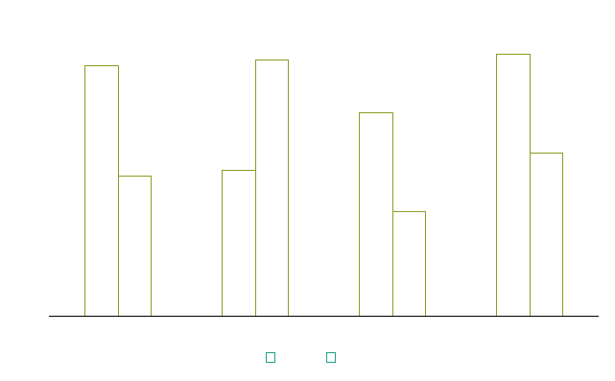
09
Chart & Data
The summary of company report 2014
By faith I mean a vision of good one cherishes and the enthusiasm that pushes one to seek its fulfillment regardless of obstacles. By faith I mean a vision of good one cherishes and the enthusiasm that pushes one to seek its fulfillment regardless of obstacles.
Don't aim for success if you want it; just do what you love and believe in, and it will come naturally.
87%
May
34%
Fed

Slide 16
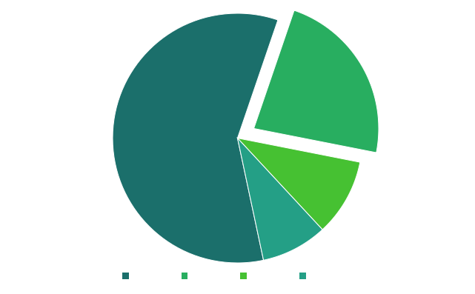
10
Chart & Data
The summary of company report 2014
Don't aim for success if you want it; just do what you love and believe in, and it will come naturally.
By faith I mean a vision of good one cherishes and the enthusiasm that pushes one to seek its fulfillment regardless of obstacles. By faith I mean a vision of good one cherishes and the enthusiasm that pushes one to seek its fulfillment regardless of obstacles.
23%

Slide 17
11
Chart & Data
Number Of Sales
87%
May
34%
Fed
26%
Jun

Slide 18
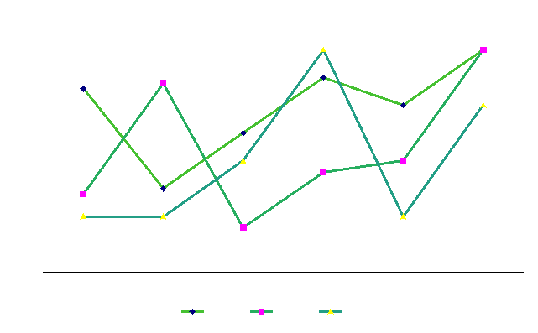
100%
100%
100%
12
Chart & Data
Satisfaction Guarantee
Satisfaction Guarantee
Satisfaction Guarantee
But all sunshine without shade, all pleasure without
But all sunshine without shade, all pleasure without
But all sunshine without shade, all pleasure without

Slide 19
13
12-34%
34-67%
12-34%
Chart & Data
Nowadays a growing number of people
Some spend the majority of the time online chatting
cheap, comfortable, and most importantly, very safe.
lack of physical exercise
face-to-face communication with others.
Nowadays a growing number of people
Some spend the majority of the time online chatting
cheap, comfortable, and most importantly, very safe.
lack of physical exercise
face-to-face communication with others.
Nowadays a growing number of people
Some spend the majority of the time online chatting
cheap, comfortable, and most importantly, very safe.
lack of physical exercise
face-to-face communication with others.
Leadership
Quality
Cooperation

Slide 20
PRODUCTS
Don't aim for success if you want it; just do what you love and believe in, and it will come naturally.

Slide 21
14
Products
Don't aim for success if you want it; just do what you love and believe in, and it will come naturally.
But all sunshine without shade, all pleasure without pain, is not life at all. Take the lot of the happiest - it is a tangled yarn. Bereavements and blessings, one following another, make us sad and blessed by turns. Even death itself makes life more loving. one following another, make us sad and blessed by turns. Even death itself makes life more loving.

Slide 22
15
Products
Don't aim for success if you want it; just do what you love and believe in, and it will come naturally.
But all sunshine without shade, all pleasure without pain, is not life at all. Take the lot of the happiest - it is a tangled yarn. Bereavements and blessings, one following another, make us sad and blessed by turns. Even death itself makes

Slide 23
16
Products
Our Product
By faith I mean a vision of good one cherishes and the enthusiasm that pushes one to seek its fulfillment regardless of obstacles. By faith I mean a vision of good one cherishes and the enthusiasm that pushes one to seek its fulfillment regardless of obstacles.
By faith I mean a vision of good one cherishes and the enthusiasm that pushes one to seek its fulfillment regardless of obstacles. By faith I mean a By faith I mean a vision of good one cherishes and the enthusiasm that pushes one to seek its

Slide 24
THANKS
Make you different

Slide 25
上万精品PPT模板全部免费下载
PPT汇 www.ppthui.com
PPT模板下载：www.ppthui.com/muban/ 行业PPT模板：www.ppthui.com/hangye/
工作PPT模板：www.ppthui.com/gongzuo/ 节日PPT模板：www.ppthui.com/jieri/
PPT背景图片： www.ppthui.com/beijing/ PPT课件模板：www.ppthui.com/kejian/
Notes:
模板来自于 https://www.ppthui.com 【PPT汇】

Slide 26
10000+套精品PPT模板全部免费下载
www.ppthui.com
PPT汇
PPT模板下载：www.ppthui.com/muban/ 行业PPT模板：www.ppthui.com/hangye/
工作PPT模板：www.ppthui.com/gongzuo/ 节日PPT模板：www.ppthui.com/jieri/
党政军事PPT：www.ppthui.com/dangzheng/ 教育说课课件：www.ppthui.com/jiaoyu/
PPT模板：简洁模板丨商务模板丨自然风景丨时尚模板丨古典模板丨浪漫爱情丨卡通动漫丨艺术设计丨主题班会丨背景图片
行业PPT：党政军事丨科技模板丨工业机械丨医学医疗丨旅游旅行丨金融理财丨餐饮美食丨教育培训丨教学说课丨营销销售
工作PPT：工作汇报丨毕业答辩丨工作培训丨述职报告丨分析报告丨个人简历丨公司简介丨商业金融丨工作总结丨团队管理
More+
Notes:
模板来自于 https://www.ppthui.com 【PPT汇】

